Slide 1
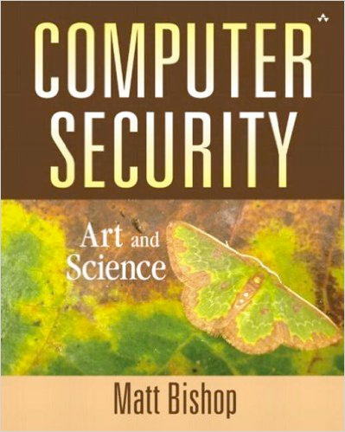
Computer and Network Security COMP 5370/637* Lecture #9 September 4, 2015
Tony Skjellum
skjellum@auburn.edu

Slide 2
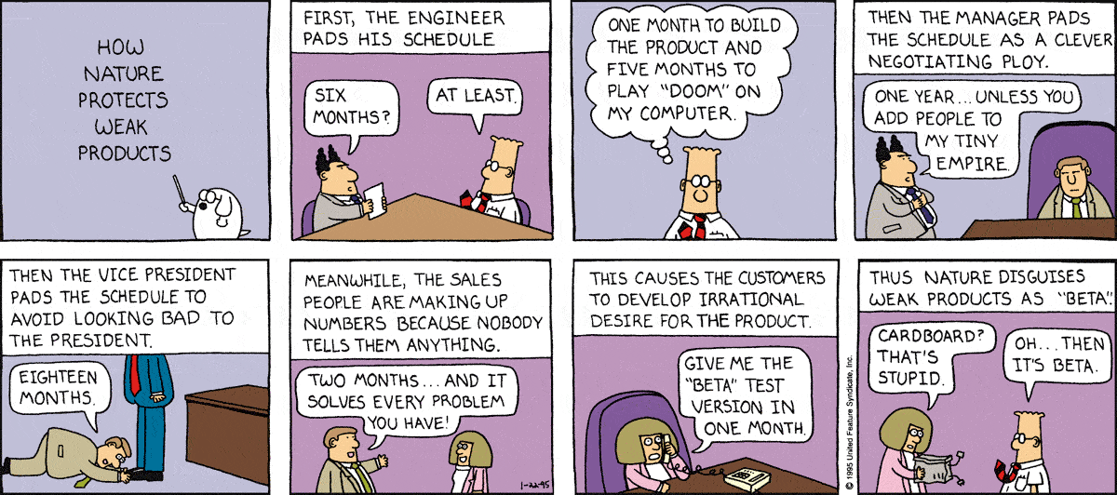
More Dilbert!
http://dilbert.com/search_results?terms=nature+beta

Slide 3
Today’s Topics
Key Management

Slide 4
Notation
X → Y : { Z || W } k_{X,Y}
X sends Y the message produced by concatenating Z and W enciphered by key k_{X,Y}, which is shared by users X and Y
A → T : { Z } k_{A} || { W } k_{A,T}
A sends T a message consisting of the concatenation of
Z enciphered using A's key, k_{A}
W enciphered using the key shared by A and T, k_{A,T},
r₁, r₂ nonces (nonrepeating random numbers)

Slide 5
Session and Interchange Keys
Interchange key – a cryptographic key associated with a principal to a communication
Used between sessions
Session key – a cryptographic key associated with the communication itself
Used only once – thrown away after session
Does not identify communicating party (authentication)
Limits amount of data enciphered by a single key
Session keys prevent forward searches
Often used in APIs, such as Facebook
Notes:
(new slide)
Forward search – attacker pre-computes all plaintexts using the target’s public key.

Slide 6
Example
Alice wants to send a message m to Bob
Assume public key encryption
Alice generates a random cryptographic key k_{s} and uses it to encipher m
To be used for this message only … session key
She enciphers k_{s} with Bob;s public key k_{B}
k_{B} enciphers all session keys Alice uses to communicate with Bob … interchange key
Alice sends { m } k_{s} || { k_{s} } k_{B}
Session
Interchange

Slide 7
Benefits
Limits amount of traffic enciphered with single key
Standard practice, to decrease the amount of traffic an attacker can exploit
Prevents some attacks
Suppose Alice sends Bob messages that consist of either “BUY” or “SELL”.
Eve computes possible ciphertexts { “BUY” } k_{B} and { “SELL” } k_{B}.
Eve intercepts enciphered message, compares, and gets plaintext at once

Slide 8
Key Exchange Algorithms
How do Alice, Bob share a key?
Premise
Secret items are the keys and any ancillary information known only to Alice and Bob needed to derive keys
Anything transmitted is assumed known to attacker
Key cannot be sent in clear. Alternatives:
Key can be sent enciphered
Key can be derived from exchanged data plus data not known to an eavesdropper
Key can be brokered by a third party

Slide 9
Classical Key Exchange
Bootstrap problem: how do Alice, Bob begin?
Alice can’t send it to Bob in the clear
Assume trusted third party, Cathy
Alice and Cathy share secret key k_{AC}
Bob and Cathy share secret key k_{BC}
Use this to exchange shared key k_{s}
{ request for key to Bob } k_{AC}
Alice
Cathy
{ k_{s} } k_{AC} || { k_{s} } k_{BC}
Alice
Cathy
{ k_{s} } k_{BC}
Alice
Bob

Slide 10
But …
How does Bob know he is talking to Alice?
Replay attack: Eve records message from Alice to Bob, later replays it; Bob may think he’s talking to Alice, but he isn’t
Session key reuse: Eve replays message from Alice to Bob, so Bob re-uses session key

Slide 11
Needham-Schroeder
Alice || Bob || r₁
Alice
Cathy
Alice sends id information + random num to Cathy
{ Alice || Bob || r₁ || k_{s} || { Alice || k_{s} } k_{BC} } k_{AC}
Alice
Cathy
Cathy responds to Alice by adding a session key, then adding Alices id + key, both enciphered for Bob, then enciphering the entire message
{ Alice || k_{s} } k_{BC}
Alice
Bob
{ r₂ } k_{s}
Alice
Bob
Alice sends Cathy's enciphered intro to Bob
{ r₂ – 1 } k_{s}
Alice
Bob

Slide 12
Needham-Schroeder
Alice || Bob || r₁
Alice
Cathy
{ Alice || Bob || r₁ || k_{s} || { Alice || k_{s} } k_{BC} } k_{AC}
Alice
Cathy
Bob responds to Alice by sending her a new rand number enciphered using the session key.
{ Alice || k_{s} } k_{BC}
Alice
Bob
{ r₂ } k_{s}
Alice
Bob
Alice responds responds, thus confirming the introduction
{ r₂ – 1 } k_{s}
Alice
Bob

Slide 13
But …
Assumption: all keys are secret
Question: suppose Eve can obtain session key. How does that affect protocol?
In what follows, Eve knows k_{s}
Eve intercepts Alice's message and impersonates Alice
This is a replay attack
{ Alice || k_{s} } k_{B}
Eve
Bob
{ r₂ } k_{s}
Eve
Bob
{ r₂ – 1 } k_{s}
Eve
Bob

Slide 14
A Solution
Alice creates session num, sends to Bob + intro enciphered with her key
n || Alice || Bob || { r₁ || n || Alice || Bob } k_{AC}
Alice
Bob
Bob appends id (including n) to Cathy enciphered with his key
n || Alice || Bob || { r₁ || n || Alice || Bob } k_{AC} ||
{ r₂ || n || Alice || Bob } k_{BC}
Cathy
Bob
Cathy responds with session keys
n || { r₁ || k_{s} } k_{AC} || { r₂ || k_{s} } k_{BC}
Cathy
Bob
Bob responds to Alice with session key
n || { r₁ || k_{s} } k_{AC}
Alice
Bob
Alice verifies num is original one she sent

Slide 15
Kerberos, 1
Authentication system
Based on Needham-Schroeder with Denning-Sacco modification
Central server plays role of trusted third party (“Cathy”)
Ticket
Issuer vouches for identity of requester of service
Authenticator
Identifies sender

Slide 16
Kerberos, 2
User u authenticates to Kerberos server
Obtains ticket T_{u,TGS} for ticket granting service (TGS)
User u wants to use service s:
User sends authenticator A_{u}, ticket T_{u,TGS} to TGS asking for ticket for service
TGS sends ticket T_{u,s} to user
User sends A_{u}, T_{u,s} to server as request to use s

Slide 17
Protocol Entities
Ticket Granting System
Credential saying issuer has identified ticket requester
Example ticket issued to user u for service s
T_{u,s} = s || { u || u’s address || valid time || k_{u,s} } k_{s}
where:
k_{u,s} is session key for user and service
Valid time is interval for which ticket valid
u’s address may be IP address or something else

Slide 18
Protocol Entities
Authentication Server
Credential containing identity of sender of ticket
Used to confirm sender is entity to which ticket was issued
Example: authenticator user u generates for service s
A_{u,s} = { u || generation time || k_{t} } k_{u,s}
where:
k_{t} is alternate session key
Generation time is when authenticator generated

Slide 19
Protocol
user || TGS
Alice
AS
get user ticket to use TGS
{ k_{alice,TGS} } k_{A} || T_{alice,TGS}
Alice
AS
service || A_{alice,TGS} || T_{alice,TGS}
Alice
TGS
Alice || { k_{alice,service} } k_{alice,TGS} || T_{alice,service}
get and use ticket for service
Alice
TGS
A_{alice,service} || T_{alice,service}
Alice
service
{ t + 1 } k_{alice,service}
Alice
service

Slide 20
Problems
Relies on synchronized clocks
If not synchronized and old tickets, authenticators not cached, replay is possible
Tickets have some fixed fields
Dictionary attacks possible
Kerberos 4 session keys weak (had much less than 56 bits of randomness)

Slide 21
Public Key Key Exchange
Interchange keys
e_{A}, e_{B} Alice and Bob’s public keys known to all
d_{A}, d_{B} Alice and Bob’s private keys known only to owner
Simple protocol
k_{s} is desired session key
Vulnerable to forgery or replay
Because e_{B} known to anyone, Bob has no assurance that Alice sent message
Simple fix uses Alice’s private key
k_{s} is desired session key
{ { k_{s} } d_{A} } e_{B}
Alice
Bob

Slide 22
Public Key Exchange
Can include message enciphered with k_{s}
Assumes Bob has Alice’s public key, and vice versa
If not, each must get it from public server
If keys not bound to identity of owner, subject to man-in-the-middle attack
send Bob’s public key
Eve intercepts request
Alice
Cathy
send Bob’s public key
Eve
Cathy
e_{B}
Eve
Cathy
e_{E}
Alice
Eve
{ k_{s} } e_{E}
Eve intercepts message
Alice
Bob
{ k_{s} } e_{B}
Eve
Bob

Slide 23
Cryptographic Key Infrastructure
Goal: bind identity to key
Classical: not possible as all keys are shared
Use protocols to agree on a shared key
Public key: bind identity to public key
Crucial as people will use key to communicate with principal whose identity is bound to key
Erroneous binding means no secrecy between principals
Assume principal identified by an acceptable name

Slide 24
Certificates
Certificate is a token that binds an identity to a cryptographic key
Typically contains:
Identity of principal (here, Alice)
Corresponding public key
Timestamp (when issued)
Other information (perhaps identity of signer)
signed by trusted authority (here, Cathy)
C_{A} = { e_{A} || Alice || T } d_{C}

Slide 25
Use
Bob gets Alice’s certificate
If he knows Cathy’s public key, he can decipher the certificate
When was certificate issued?
Is the principal Alice?
Now Bob has Alice’s public key
Problem: Bob needs Cathy’s public key to validate certificate
Problem pushed “up” a level
Two approaches: Merkle’s tree, signature chains

Slide 26
Certificate Signature Chains
Create certificate
Generate hash of certificate
Encipher hash with issuer’s private key
Validate
Obtain issuer’s public key
Decipher enciphered hash
Recompute hash from certificate and compare
Problem: getting issuer’s public key

Slide 27
X.509
Standard for public key infrastructure (PKI)
centralized trust model where keys are maintained by a common custodian
A Certification Authority issues a certificate binding a public key to an entity
Root certificate distributed
root certificate is top-most certificate in tree
contains private key is used to sign child certificates
child certificates inherit trustworthiness of parent
IE, Firefox, Safari, Chrome come with set of root certificates preinstalled

Slide 28
X.509 Chains
Some certificate components in X.509v3:
Version
Serial number
Signature algorithm identifier: hash algorithm
Issuer’s name; uniquely identifies issuer
Interval of validity
Subject’s name; uniquely identifies subject
Subject’s public key
Signature: enciphered hash

Slide 29
X.509 Certificate Validation
Obtain issuer’s public key
The one for the particular signature algorithm
Decipher signature
Gives hash of certificate
Recompute hash from certificate and compare
If they differ, there’s a problem
Check interval of validity
This confirms that certificate is current

Slide 30
Issuers
Certification Authority (CA): entity that issues certificates
Multiple issuers pose validation problem
Alice’s CA is Cathy; Bob’s CA is Don; how can Alice validate Bob’s certificate?
Have Cathy and Don cross-certify
Each issues certificate for the other

Slide 31
Validation and Cross-Certifying
Certificates:
Cathy<<Alice>>
Dan<<Bob>
Cathy<<Dan>>
Dan<<Cathy>>
Alice validates Bob’s certificate
Alice obtains Cathy<<Dan>>
Alice uses (known) public key of Cathy to validate Cathy<<Dan>>
Alice uses Cathy<<Dan>> to validate Dan<<Bob>>

Slide 32
PGP Chains, 1
Uses a web of trust (WoT) model
decentralized model
anyone can sign and attest validity of others' certificates
PGP creator, Phil Zimmermann:
As time goes on, you will accumulate keys from other people that you may want to designate as trusted introducers. Everyone else will each choose their own trusted introducers. And everyone will gradually accumulate and distribute with their key a collection of certifying signatures from other people, with the expectation that anyone receiving it will trust at least one or two of the signatures. This will cause the emergence of a decentralized fault-tolerant web of confidence for all public keys.

Slide 33
PGP Chains, 2
OpenPGP certificates structured into packets
One public key packet
Zero or more signature packets
Public key packet:
Version
Creation time
Validity period (not present in version 3)
Public key algorithm, associated parameters
Public key

Slide 34
PGP Chains, 3
Signature packet
Version
Signature type (level of trust)
Creation time (when next fields hashed)
Signer’s key identifier (identifies key to encipher hash)
Public key algorithm (used to encipher hash)
Hash algorithm
Part of signed hash (used for quick check)
Signature (enciphered hash)

Slide 35
Signing
Single certificate may have multiple signatures
Each signatures "endorses" public key with owner
Notion of “trust” embedded in each signature
Range from “untrusted” to “ultimate trust”
Can include voting scheme
e.g., 2 partially trusted endorser have voted for certificate + 1 fully-trusted endorsers
Signer defines meaning of trust level (no standards!)
Keys signed by subject
Called “self-signing”

Slide 36
Validating Certificates
Alice needs to validate Bob’s OpenPGP cert
Does not know Fred, Giselle, or Ellen
Alice gets Giselle’s cert
Knows Henry slightly, but his signature is at “casual” level of trust
Alice gets Ellen’s cert
Knows Jack, so uses his cert to validate Ellen’s, then hers to validate Bob’s
Jack
Henry
Ellen
Irene
Giselle
Fred
Bob
Arrows show endorsements

Slide 37
PKI vs WoT
PKI
puts trust decision at single point
root certificate widely distributed
WoT
leaves trust decisions in hands of users
certificates not widely distributed, but may be difficult to get

Slide 38
Common Issues
Storing and protecting keys
Encipher file containing key
Attacker can monitor keystrokes to decipher files
Key will be resident in memory that attacker may be able to read
Common solution
Use physical devices like “smart card”
Key never enters system
Card can be stolen, so have 2 devices combine bits to make single key

Slide 39
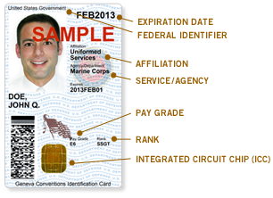
Common Access Card
Identification mechanism for DoD personnel
provides visual identification
provides electronic authentication
bar code
magnetic strip
integrated circuit
includes PIN and PKI certificates:
ID certificate
signature certificate
encryption certificate
encrypted with 2048-bit key

Slide 40
Common Access Card
Electronic authentication based on X.509
Card is inserted into reader, user provides PIN
PIN is matched with the stored PIN on the card
if unsuccessful three times, CAC is locked
If successful
Electronic Data Interchange Personal Identifier (EDIPI) number is obtained from the PKI certificate on the card
EDIPI sent to a processing system where matched with an access control system, such as Active Directory or LDAP.

Slide 41
Common Issues
Key revocation
Certificates contain key expiration date, but what happens if key is invalidated before expiration?
Due to compromised key
Due to change in circumstance (e.g., someone leaving company)
Concerns
Ensure that key revocation is authorized
Revocation information circulates to everyone fast enough
Network delays, infrastructure problems may delay information

Slide 42
Common Issues
Key revocation (con't)
Common solution
certificate revocation list: certificates that are no longer valid
X.509: only certificate issuer can revoke certificate
Added to CRL
PGP: signers can revoke signatures; owners can revoke certificates, or allow others to do so
Revocation message placed in PGP packet and signed
Flag marks it as revocation message

Slide 43
Digital Signature
Is a construct that authenticates both the origin and contents of a message so as to be provable to a disinterested third party ("judge")
Effect: sender cannot deny having sent message
i.e., provides nonrepudiation
Limited to technical proofs
Inability to deny one’s cryptographic key was used to sign
One could claim the cryptographic key was stolen or compromised … not dealt with here

Slide 44
Common Error
Classical: Alice, Bob share key k
Alice sends m || { m }_{k} to Bob
This is a digital signature, right?
No
This isn't a digital signature.
A third party can't determine whether Alice or Bob generated message

Slide 45
Classical Digital Signatures
Merkle scheme: require trusted third party
Alice, Bob each share keys with trusted party Cathy
To resolve dispute,
judge gets { m } k_{Alice}, { m } k_{Bob},
and has Cathy decipher them
if messages matched, contract was signed
{ m }k_{Alice}
Alice
Bob
{ m }k_{Alice}
Cathy
Bob
{ m }k_{Bob}
Cathy
Bob

Slide 46
Public Key Digital Signatures
Alice’s keys:
private d_{Alice}
public e_{Alice}
Alice sends Bob
m || { m } d_{Alice}
In case of dispute
Judge computes
{ { m } d_{Alice} } e_{Alice}
If it is m, Alice signed message
because she’s the only one who knows d_{Alice}

Slide 47
RSA Digital Signatures
Use private key to encipher message
Protocol for use is critical
Key points:
Never sign random documents, and when signing, always sign hash and never document
Mathematical properties can be turned against signer
Sign message first, then encipher
Changing public keys causes forgery

Slide 48
Spy, 1
The scenario
Alice: n_{A} = 95, e_{A} = 59, d_{A} = 11
Bob: n_{B} = 77, e_{B} = 53, d_{B} = 17
Alice has 26 contracts, numbered 00 – 25,
The setup
Alice has Bob sign 05 and 17 with his private key:
c₀₅ = m^{dB} mod n_{B} = 05¹⁷ mod 77 = 3
c₁₇ = m^{dB} mod n_{B} = 17¹⁷ mod 77 = 19

Slide 49
Spy, 2
The sting
Alice exploits RSA (i.e., m₁m₂ mod n_{Bob} = m)
She computes 05⋅17 mod 77 = 08
Corresponding signature is 03⋅19 mod 77 = 57;
Claims Bob signed 08
Judge computes c^{eB} mod n_{B} = 57⁵³ mod 77 = 08
Signature validated
Bob is toast

Slide 50
Spy vs Spy
Bob, Alice agree to sign contract 06
Alice enciphers, then signs:
(m^{eB} mod 77)^{dA} mod n_{A} = (06⁵³ mod 77)¹¹ mod 95 = 63
Bob changes his public key
Computes r such that 13^{r} mod 77 = 6; say, r = 59
Computes re_{B} mod φ(n_{B}) = 59⋅53 mod 60 = 7
Replace public key e_{B} with 7, private key d_{B} = 43
Bob claims contract was 13. Judge computes:
(63⁵⁹ mod 95)⁴³ mod 77 = 13
Verified … now Alice twisting slowly in the wind as the zombies nip at her feet
Lesson: Strength of system relies on the protocol for how to authenticate as well as cryptosystem itself

Slide 51
Key Points
Key management critical to effective use of cryptosystems
Different levels of keys (session vs. interchange)
Keys need infrastructure to identify holders, allow revoking
Key escrowing complicates infrastructure
Digital signatures provide integrity of origin and content
Much easier with public key cryptosystems than with classical cryptosystems

Slide 52
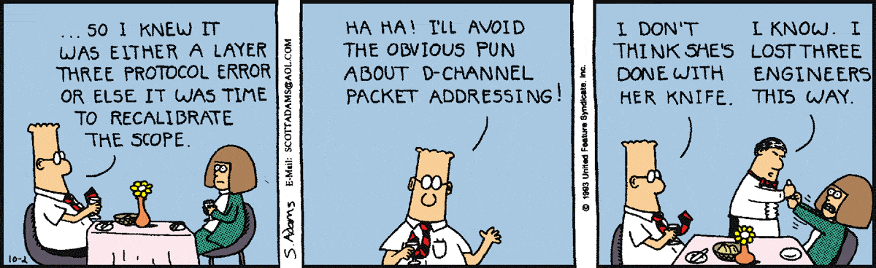
Final thoughts for today
http://dilbert.com/search_results?terms=Hacker

Slide 53
Homework
Implement blowfish encryption and decryption on TCP-IP Client-Server socket model ( your 1st assignment).
Due date - September 14th 2015(Monday)

